Slide 1
7. třída – English 27th – 30th April
We are going to continue in our film topic this week.
Last week your homework was:
Watch English film and write a short film report.
Workbook exercise 59/4
The online lesson on Wednesday 29. 4. at 11:00 is going to be about the films you watched, Deanne is going to tell us something about the films she likes.

Slide 2
Lesson 1 – Have to - revision
Opakování z minulého týdne, přečtěte si:
Kladné věty:
Have to/has to + sloveso = muset, mít povinnost něco udělat
I have to get up at seven o´clock. She has to do her homework. We have to practice the piano.
Záporné věty:
do not (don´t) have to + sloveso, does not (doesn´t) have to + sloveso
I don´t have to go to school now. He doesn´t have to get up early.
We don´t go to the cinema very often.
Here you can do some practice, email me the answers
https://www.liveworksheets.com/yt33274sz

Slide 3
Have to -questions
Protože v záporné větě použiju DO nebo DOES, stejně tak to bude platit v otázce:
DO you have to get up early? No, I don´t.
DOES she have to practice the piano? Yes, she does.
When DOES she have to practice? At three o´clock.
DO they have to go home? Yes, they do.
Why DO they have to go? They have to help their mum.
Zkuste v pracovním sešitě str. 59 vytvořit otázky a odpovědět podle pravdy. Použijte HAVE TO

Slide 4
Lesson 2 – British films
Textbook p. 76 - Read the text. In your exercise book:
76/2a Complete the chart for each film in the text
76/3 Answer the questions
76/4 Listen and answer the questions:
Audio also here https://elt.oup.com/student/project/level2/unit6/audio?cc=cz&selLanguage=cs
Listening 76/4 | GIRL 1 | BOY | GIRL 2
Favourite character
Favourite film
When, where did they watch it?
You can check your answers on next page:

Slide 5
You can check your answers:

Slide 6
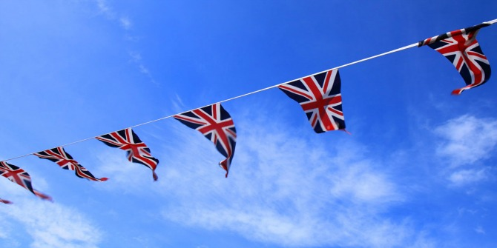
How British are you?
Try this Kahoot. PIN 06478234
https://kahoot.it/challenge/06478234?challenge-id=16bc5da8-c458-4043-a046-ba03a74f7739_1587893244205

Slide 7
That is all for this week!
1st of May is May Day – a holiday in Britain and in the USA
This is how they celebrate May Day in the US, watch the video, it is amazing what they can do with the ribbons.
https://www.youtube.com/watch?v=ncIAdeQGxoo

